Slide 1
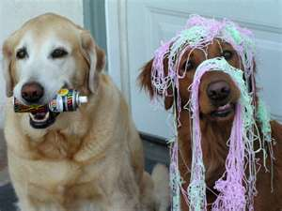
Silly Strings
String Manipulation in the Microsoft Universe

Slide 2

I know what we are going to do Today
don-E’s usual rant
Regular Expressions
Using RegEx in ASP.NET
Where to find more
Manipulating strings in SQL

Slide 3

Review
Golden rules of programming
1.Good design is making good decisions so users can’t make bad ones
2.Tackle a difficult problem by redefining it as a series of solved problems.
Regular Expressions are best example of second rule, worst example of the first rule

Slide 4
Keep ‘em Separated
Logic
Presentation
Data
Remember keep data, logic and presentation separate
This rule will let you better understand when to use regular expressions
Let’s look at a demo

Slide 5

User See,user DO
3 types of entry
Intended
Unintended
Confused
Data and Format Together

Slide 6

DATA
Should be pure
Remove the formatting from data
Examples
123-45-1234 (Format and Data)
123451234 (Data)
June 12, 11 (Format and Data)
DateTime(2011,6,1) Data

Slide 7
Presentation
Remember that user
They don’t distinguish between format and data
When format changes they might view it as a separate thing
They might even think it is wrong if not in proper format
What is 20111112?

Slide 8

How REGEX can help
Regular Expressions can help you eliminate Unintended user entries
Regular Expressions can help you remove user formatting from intended data
Regular Expressions can help you format data for users so they can understand it
Regular Expressions are logic , not text

Slide 9


History of strings
Unix
Regular Expressions
GREP
PERL
All modern languages support
But all support is different between languages and sometimes platforms

Slide 10

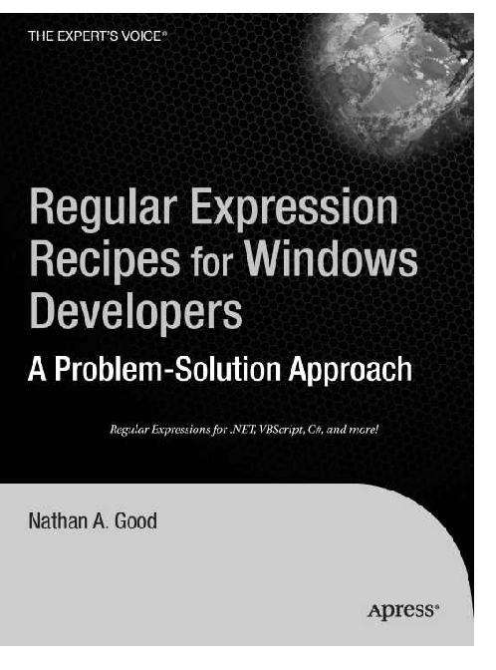
Some Basic Concepts
We have a book which gives examples of solved solutions
Recipes we can use or modify from
RegEx can appear between / /

Slide 11
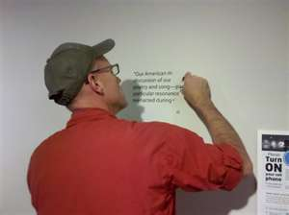
Some Practical Applications in ASP.nET
Regular Expression Validators
Scraping text
Note that JavaScript and C# don’t implement the same
So some RegEx will work in server but not in client

Slide 12

Alpha and Omega
^ at start of regex means start of line
$ at end of regex means end of line
Use these in validators to get more consistent behaviors
Note if these appear elsewhere their superpowers change

Slide 13

How Many
*
zero or more
+
One or more times
?
One or zero
{,}
{,8} is must have zero to eight
{2,} is must have two or more
{1,50} is must have 1 to 50

Slide 14

Examples
Let’s play
Validators must be 100% to be true
Server side must have any matches to be true

Slide 15

Special Education
.
Wildcard means anything
\s
Space
\d
Digit
\n
Newline
\r
Return
\t
Tab
\w
Word anchor

Slide 16

Let’s Play

Slide 17
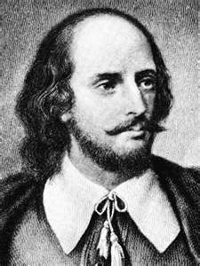
To be or not BE
[Y] vs [Y|N]
This or that
[a-z]
In this range
[^a-z]
Find a through z …not

Slide 18

Capture the flag
(groups)
(?<protocol>http|ftp)
Check out the free RAD software Regular expression application

Slide 19

Greed is Good
test"t" q"t“
Using ".*" vs ".*?“
*? Is lazy
* is greedy

Slide 20

Look at the book
Look aheads
Look behinds
Can’t do topic justice in time frame

Slide 21
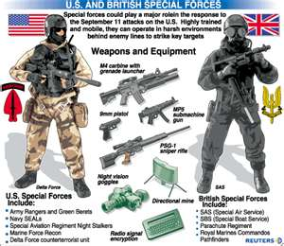
Special FORCES
EMPLID
SSN
ZIP
EMAIL
IP ADDRESS
Max Length
Min Length

Slide 22

Use them to Search in your IDE
Can use RegEx in VS
http://msdn.microsoft.com/en-us/library/2k3te2cs.aspx
Can use in Notepad++
Plug in for visual understanding

Slide 23
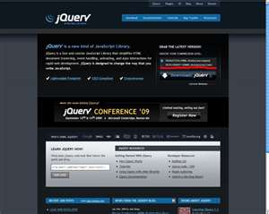
Jquery
Its all about string manipulation
That is all it does
Some hand crafted Jquery

Slide 24

TELERIK Controls
Input Manger
RadInput

Slide 25

Yes Virgina SQL can HAVE REGEX
CLR functions
Create a function in C# move it to SQL
Can’t be 4.0 yet

Slide 26
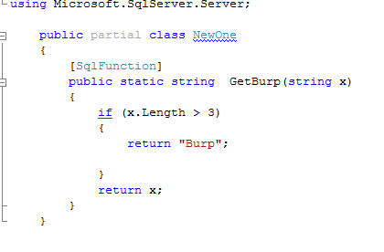
PROCS FOR PROCS
Create a class
using Microsoft.SqlServer.Server;
using System.Data.SqlTypes;
Create a public partial class
Create a public static function
Add [SqlFunction] attribute
Compile

Slide 27
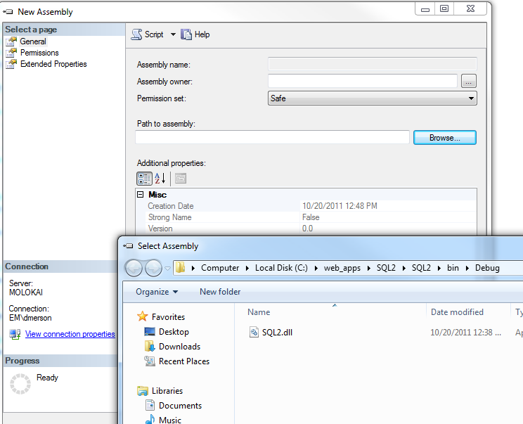
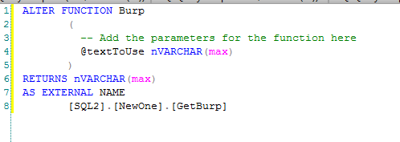
When you Get to SQL
Add assembly with SAFE
Create SQL Function

Slide 28
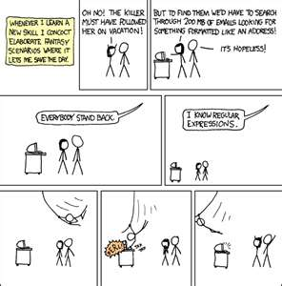
REG EX EXAMPLE
http://www.codeproject.com/KB/database/SqlRegularExpressions.aspx?display=Print
Let’s look at the project

Slide 29
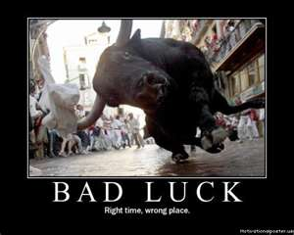
OTHER NOTES
I haven’t had luck with VS 10 integrated projects
We can do any type of string manipulation-DBAs just ask for it

Slide 30

That’s It
Power of Reg Ex
Folly of Reg Ex
CLR SQL

